Slide 2
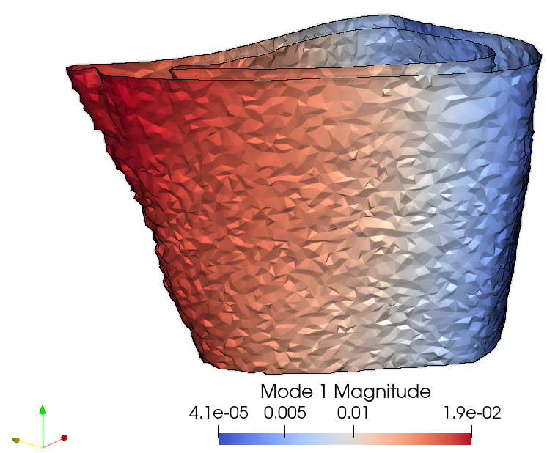
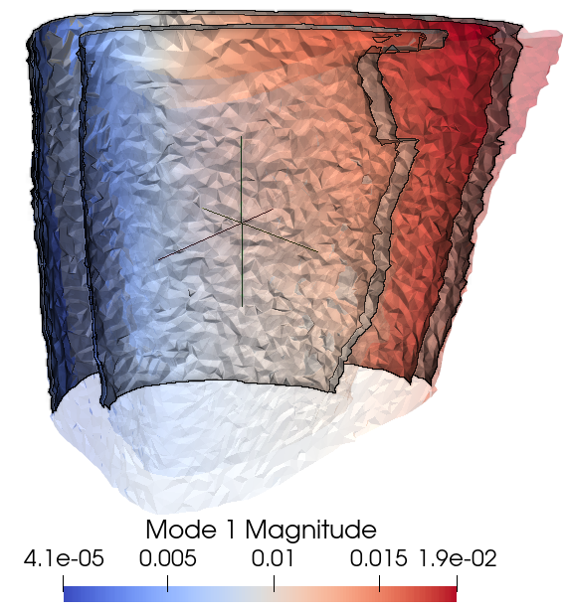
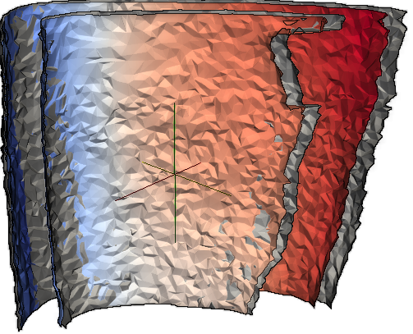
A OR B?
A
B
Comment: The grey is the mean mode shape after treatment, the multi-coloured before
Too much space

Slide 3
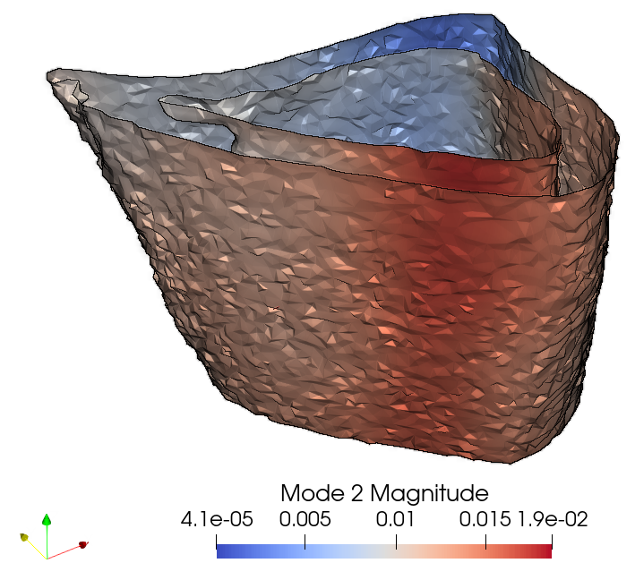
1st Mode shape
2nd Mode shape

Slide 4
Comment: Which figure?

Slide 5
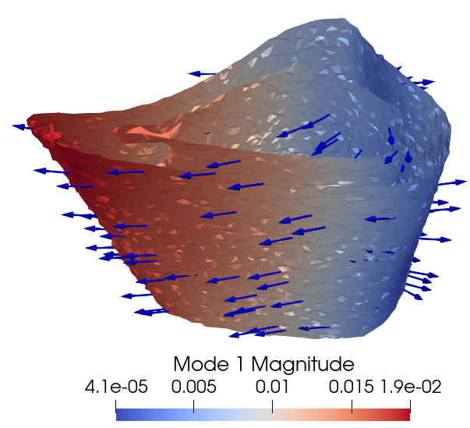
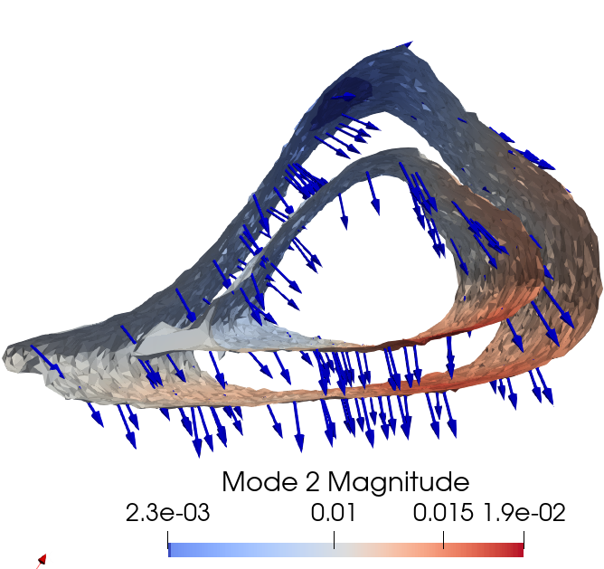
1st Mode shape
2nd Mode shape

